Slide 1



Simulation Game Use space instead of consuming it
LOESS has received funding from the European Union’s Horizon Europe research and innovation programme under the grant agreement No. 101112707
Notes:
SiWar game Use space instead of consuming it

Slide 2






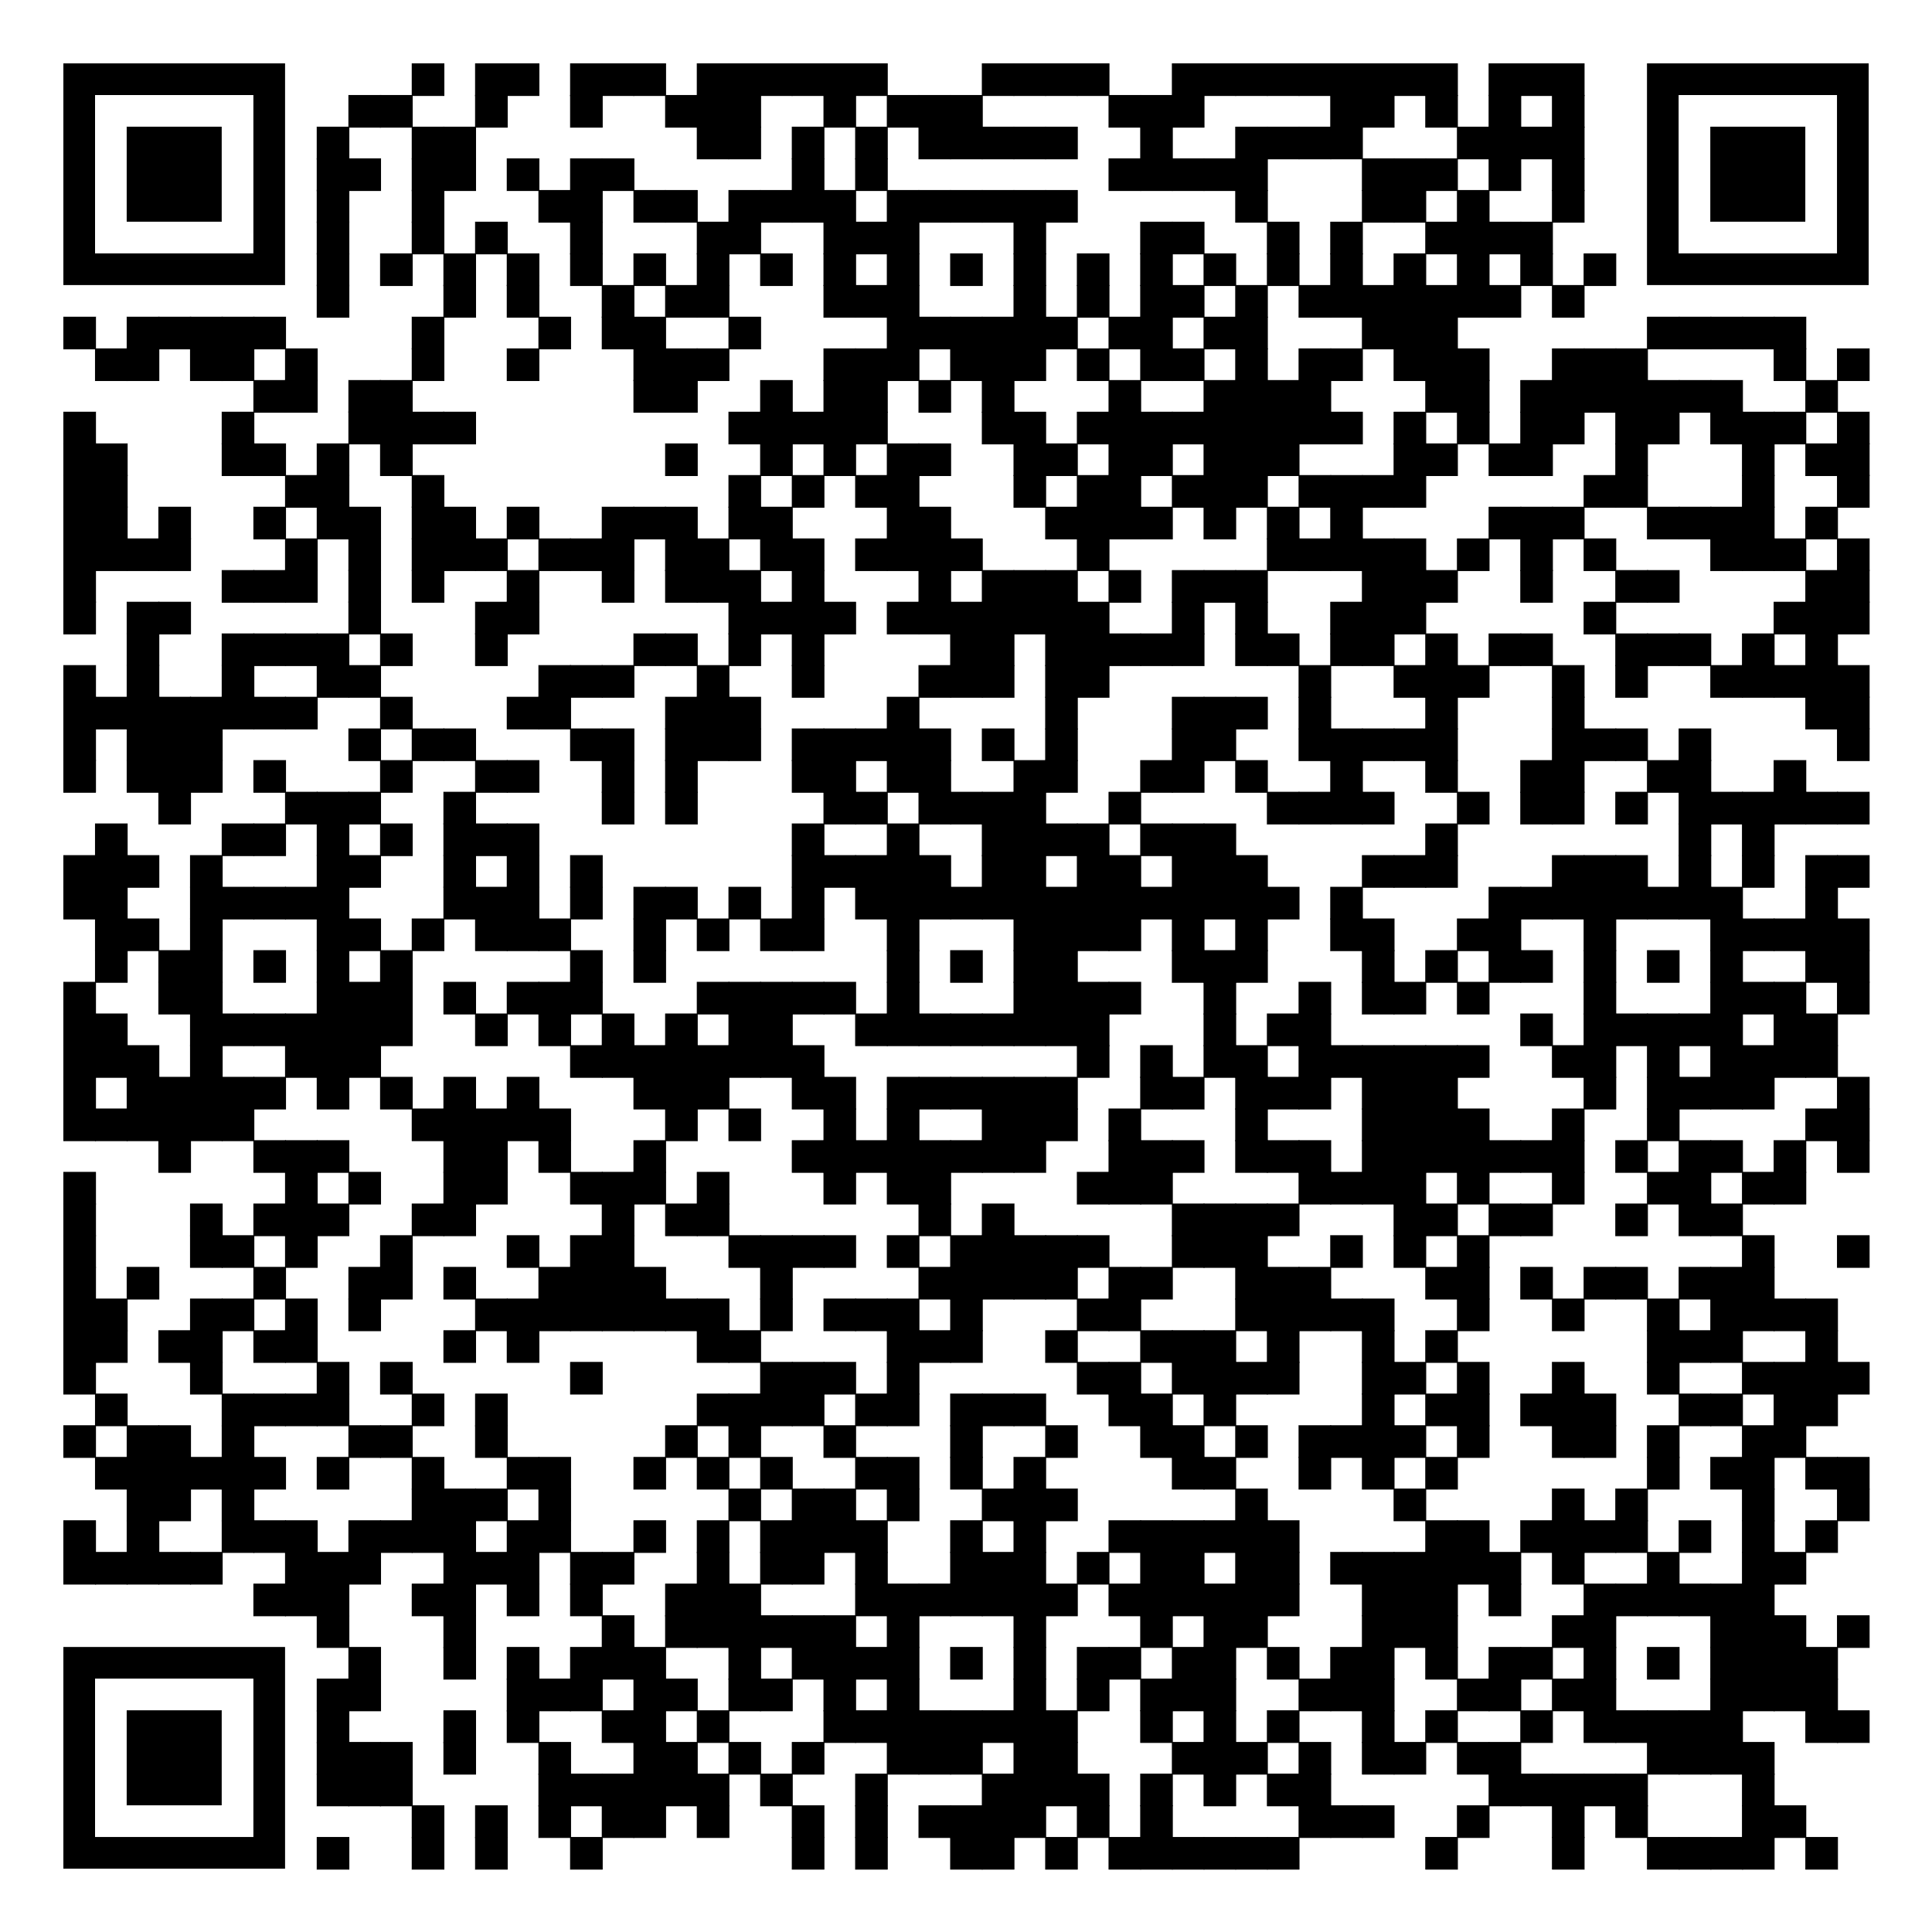
loess-project.eu
| LOESSproject
What is LOESS? Why LOSES? Why a simulation game?
EU missions offer a new opportunity to find concrete solutions to some of our biggest challenges. They have ambitious goals and aim to deliver concrete results by 2030. In this context, LOESS is funded by the mission "A Land Deal for Europe". This European programme is committed to restoring soil health. The focus of LOESS is on the development of educational and continuing education programmes as well as competence development measures for various actors, stakeholders and target groups. Soil is an indispensable ally for climate change mitigation and adaptation. That's why people need more than just scientific information: we all need to understand how healthy soils affect our lives. This simulation game was originally developed by the State Working Group Agenda 21 (LAG 21) in cooperation with the Science Shop Bonn (WilaBonn) and was awarded as an official project of the deUN World Decade of Education for Sustainable Development. It was developed for use in Germany and combines insights into democratic processes with concrete reference to the environmental issue of land use/soil.)

Slide 3


Aim of the simulation game
1) Getting to know the work of a council Decision-making in the Council Tasks of the Council members
2) Raising awareness of the issue of land use
Land consumption: Conversion of natural areas into settlement and transport areas Consequences: loss of important soil functions, loss of biodiversity, risk of flooding, spaces of rest and recreation decrease, etc. Reasons: increase in private households with a declining population, frayed settlement structure, low land prices, etc.
LOESSproject
loess-project.eu

Slide 4
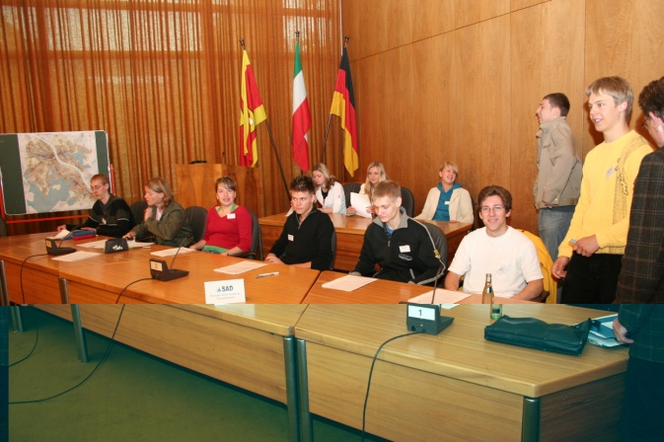
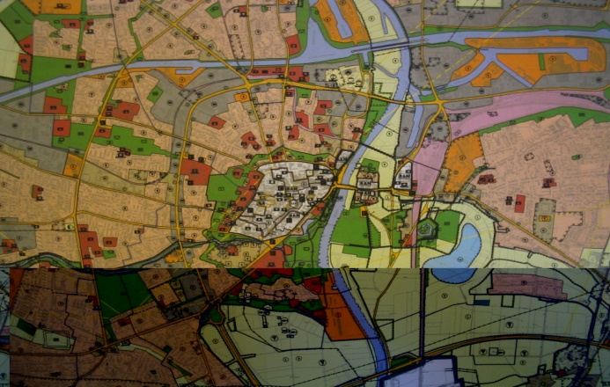
Procedure of the simulation game
The participants form the council of a municipality: division into parliamentary groups and committees, election of the chairperson, etc. Dealing with a council motion on a topic-relevant to the area Simulation of a council decision after approx. 4 1/2 hours In reality, the process from the council application to the council decision extends over several weeks
Informaiton for Game Moderators: A general introduction and all materials and templates are available and (besides translation) are ready to use. See the document: "Policy decision making on how land is used - A Role-Playing Game"
LOESSproject
loess-project.eu

Slide 5
The council as a representative of the citizenry
Council Composed of parliamentary groups of the elected parties, although there may also be non-party council members Decides on fundamental matters of the municipality and controls the administration in the implementation of resolutions The mayor chairs the council and represents the municipality externally
Faction Group of councillors of a party elected to the council
Committee Body with special responsibility defined by the municipal code Prepares council decisions professionally
LOESSproject
loess-project.eu

Slide 6

Parliamentary groups and committees of the simulation game
Factions: Social Workers' Party of Germany (SAD) SAD Christian People's Party (CVP) Ecological List (ÖL) Liberal Party of Germany (LPD)
Coalition: SAD and OIL
Committees: Planning and Environment Committee Main Committee
C
V
P
ÖL
LPD
LOESSproject
loess-project.eu

Slide 7
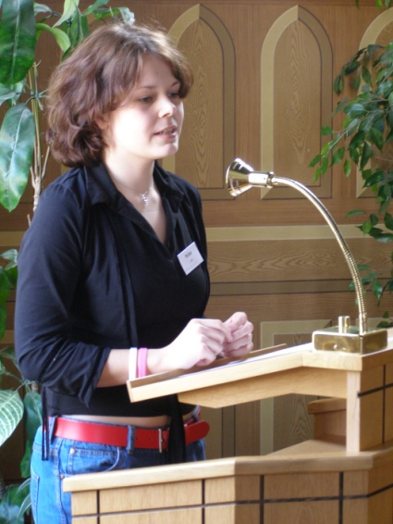
Council members with special functions
Mayor
Chairperson of the Council and Main Committee Ensures orderly and on-schedule discussion
Chairperson of the parliamentary group
Ensures orderly and on-schedule discussion in the parliamentary group Finding consensus on questions of goals and strategies Agreements with other parliamentary group chairmen
Committee Chair
Ensures orderly and timely discussion in the committee Summarises the results of the deliberations as a recommendation for a resolution
LOESSproject
loess-project.eu

Slide 8
Schedule of the simulation game
09:30-09:50 Reading phase 09:50-10:30 First parliamentary group meeting 10:30-10:40 Break 10:40-10:50 First Council Meeting 10:50-11:50 Committee work 11:50-12:20 Second parliamentary group meeting 12:20-12:30 Break 12:30-12:50 Second Council Meeting 12:50-13:10 Evaluation
LOESSproject
loess-project.eu

Slide 9


FURTHER INFORMATION
loess-project.eu
LOESSproject
LOESS has received funding from the European Union’s Horizon Europe research and innovation programme under the grant agreement No. 101112707

